Slide 1

An Overview of the Trilinos Core Products
Unclassified Unlimited release
Roger Pawlowski
HPSF Conference 2025
May 5-8, 2025, Chicago, IL
SAND2025-05583C

Slide 2
Core Area provides foundational Capabilities for Packages
Performant data structures
Abstraction layers (for linear algebra, linear solvers and nonlinear analysis)
Utility libraries
Common look and feel
Includes “snapshotted” packages: Kokkos, Kokkos-Kernels and SEACAS

Slide 3
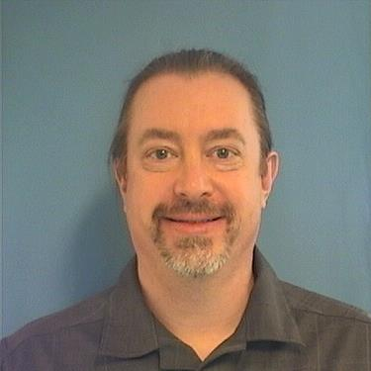
Core Area – Provides basic capabilities
Roger Pawlowski
Alegbra/Numerics
Kokkos (@kokkos) | Performance portability library | Christian Trott (@crtrott)
Kokkos Kernels (@kokkos-kernels) | Optimized math kernels for Kokkos library | Luc Berger-Vergiat (@lucbv)
RTOp (@rtop) | Vector Reduction/Transformation OPerators | Ross Bartlett (@bartlettroscoe)
Thyra (@thyra) | Abstract numerical algorithms and interfaces | Ross Bartlett (@bartlettroscoe)
Tpetra (@tpetra) | Distributed linear algebra objects | Chris Siefert (@csiefert2)
Utilities
Galeri (@galeri) | Matrix generation tools | Jonathan Hu (@jhux2)
PyTrilinos2 (@pytrilinos2) | Python bindings for Trilinos packages | Christian Glusa (@cgcgcg)
SEACAS (@SEACAS) | Utilities supporting finite element analysis | Greg Sjaardema (@gsjaardema)
Teuchos (@teuchos) | Common tools (smart pointers, parameter lists, …) | Roger Pawlowski (@rppawlo)
Meshing / Domain Decomposition
Pamgen (@pamgen) | Mesh generation tools for simple shapes | Roger Pawlowski (@rppawlo)
Zoltan/Zoltan2 (@zoltan, @zoltan2) | Load balancing and partitioning | Erik Boman (@egboman)
PyTrilinos: Christian Glusa’s talk @4:40pm

Slide 4
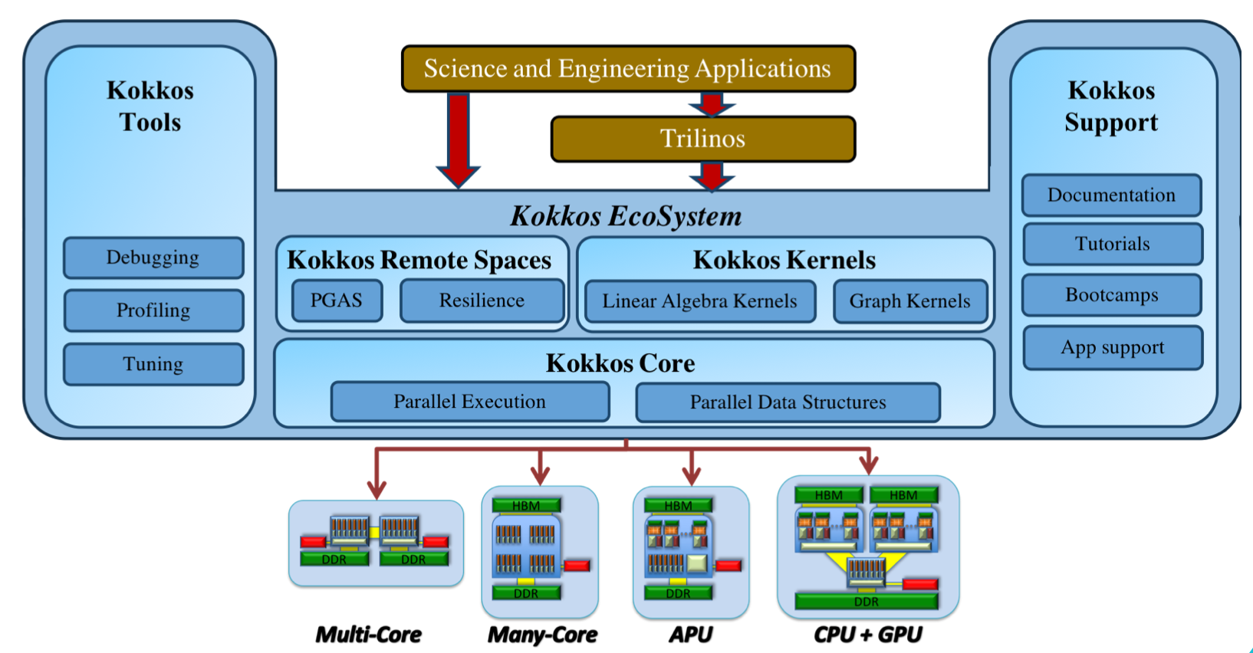
Performance Portability: Kokkos™
Shared memory programming model in C++
Write once, run on many architectures
Thread scalable parallel patterns: for, reduce, scan, task
Execution and Memory spaces
Multidimensional array with compile-time polymorphic layouts
Kokkos devs are on the c++ committee
https://github.com/kokkos/kokkos

Slide 5
Performance Portable linear Algebra: Kokkos-Kernels
KokkosKernels provides math kernels for dense and sparse linear algebra as well as graph computations.
Portable BLAS, Sparse and Graph kernels
Generic implementations for various scalar types and data layouts
Access to major vendor optimized math libraries.
Expand the scope of BLAS to hierarchical implementations.
Batched BLAS

Slide 6
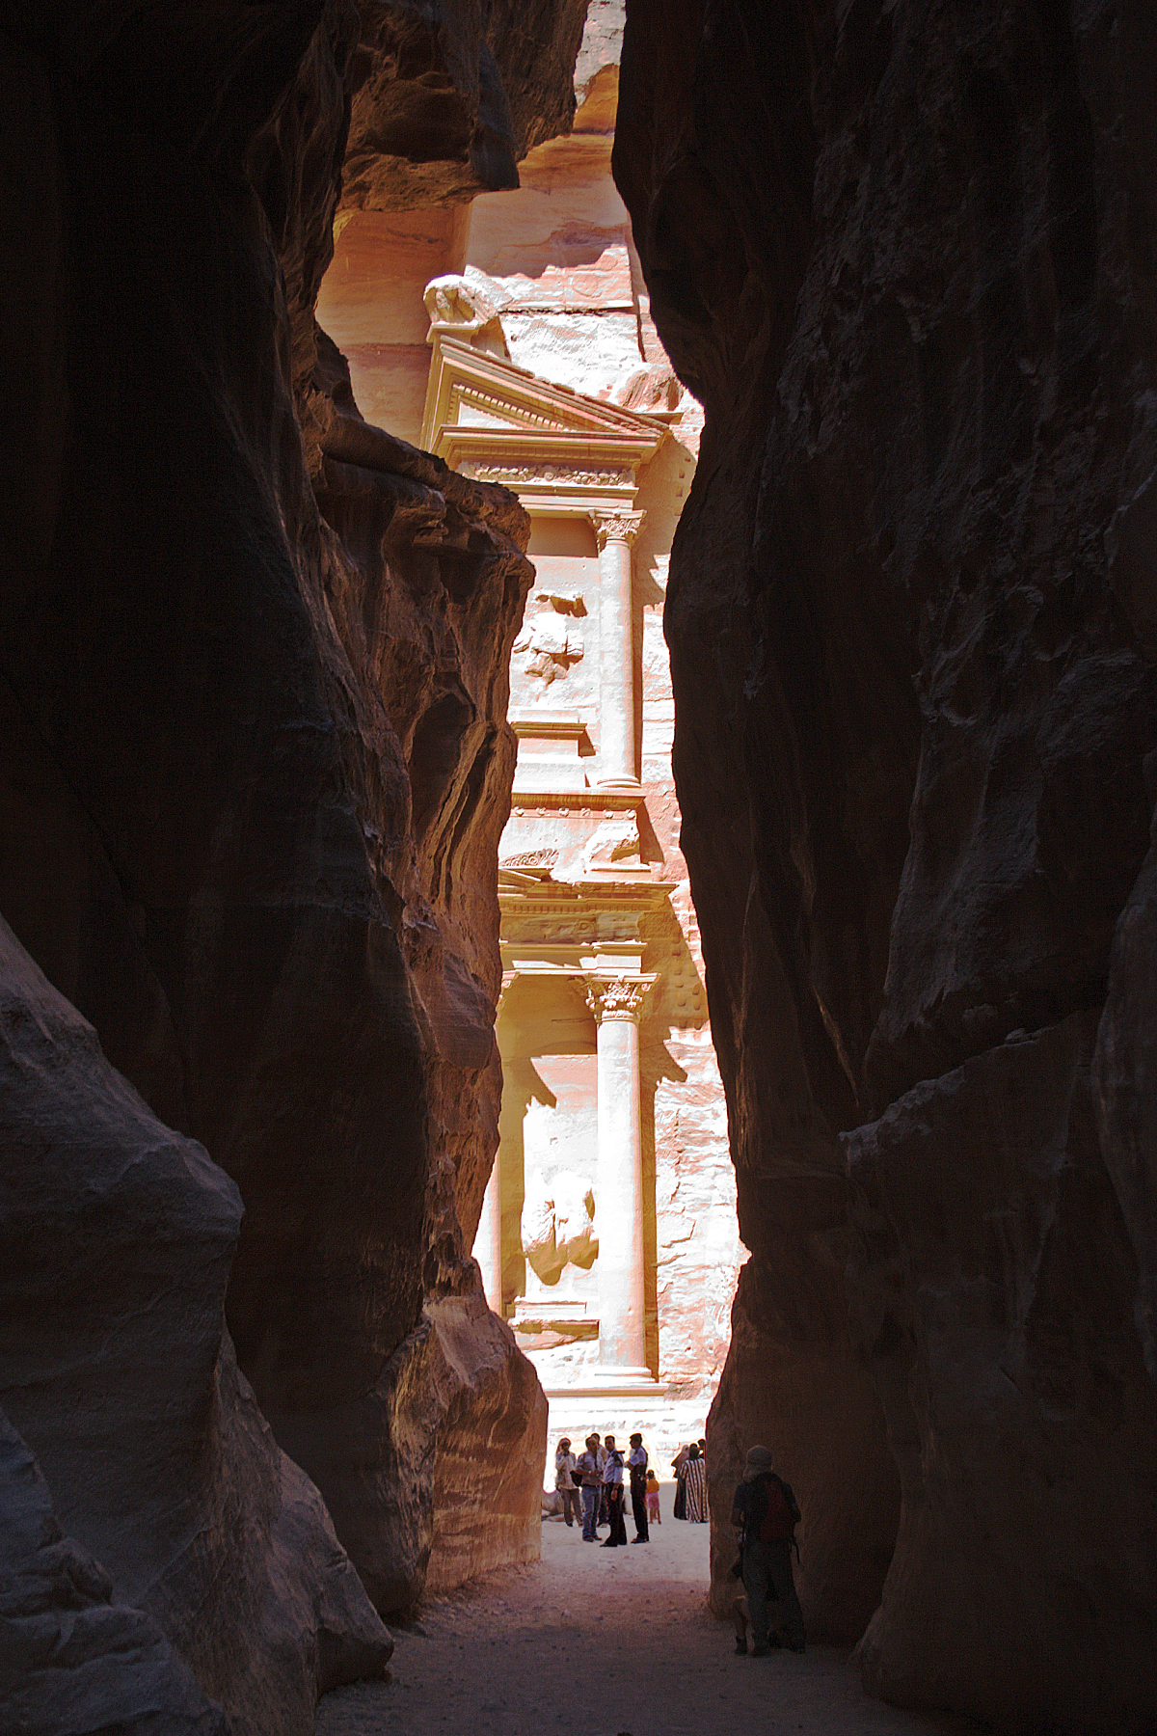
Parallel Sparse Linear Algebra: TPETRA
Basic building blocks for Trilinos solvers and preconditioners
Provides
Maps (distributed index array)
Sparse graphs, (block) sparse matrices, & dense vectors/multivectors
Norms, SpMV, SpGEMM, …
MPI communication & data (re)distribution
Fill: {Create,modify} {graph,matrix,vector}
Key features
Can pick type of values (real, complex, automatic differentiation, ensemble, …)
Detailed performance monitoring (see Chris Siefert’s talk @4:20pm)
Image source: https://en.wikipedia.org/wiki/Siq#/media/File:Petra_First_Glimpse.jpg

Slide 7
Solver Abstraction Layer: Thyra
Abstractions for:
Vector/Operator (+Blocked wrappers)
Linear solvers/Preconditioners
Nonlinear solvers
Physics model interface (solver callback API)
Matrix/Vector operations are handled in native data structures
Tpetra, Epetra, PETSC, …
Used to write higher level packages/algorithms
Wrapper to all linear solver/preconditioners (Stratimikos)
Physics-based block preconditioners (TEKO)
Nonlinear solver (NOX)
Time integration (Tempus)
Optimization (ROL)
Bifurcation/Stability Analysis (LOCA)
See Malachi Phillips’s Talk @4pm

Slide 8
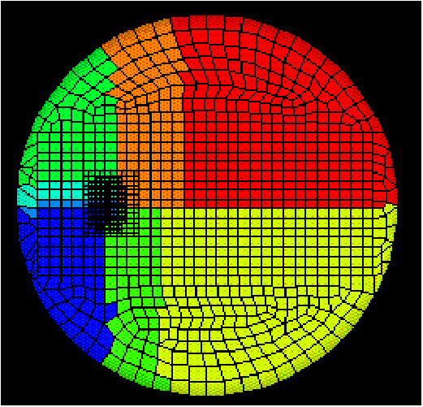
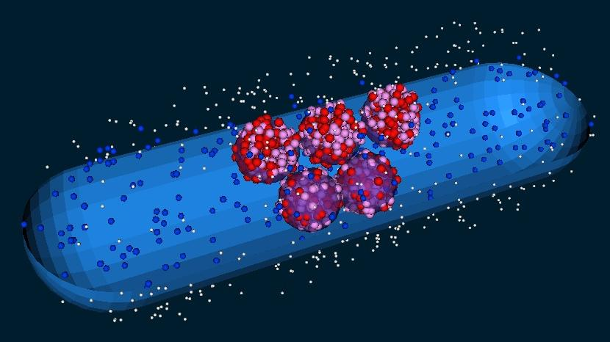
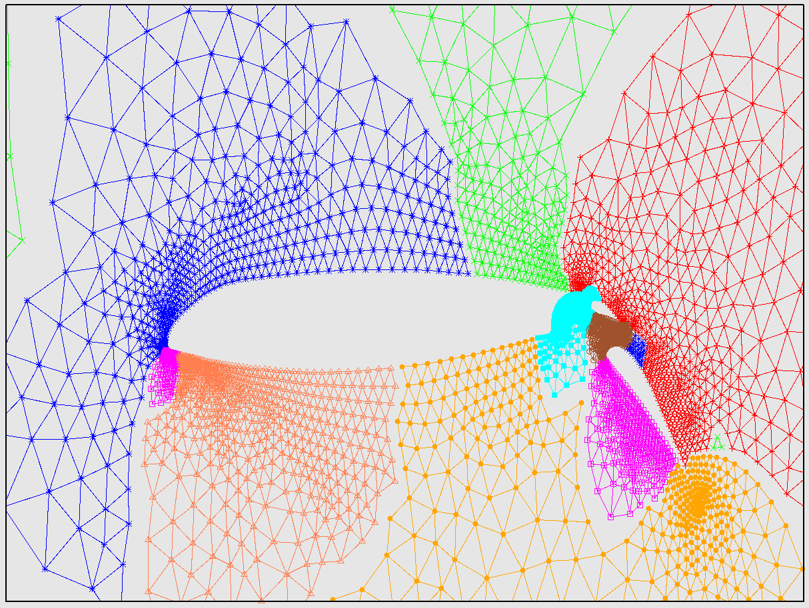
Parallel Partitioning and Load Balancing: Zoltan/Zoltan2
Zoltan and Zoltan2 are packages for partitioning, load balancing, and combinatorial scientific computing
Both have a collection of algorithms (geometric partitioning, graph, hypergraph, etc.)
Zoltan is quite old (~2000) and can be used stand-alone on CPUs
Zoltan2 is fairly new and a tightly integrated Trilinos package
Supports Kokkos and GPUs
Works with Tpetra matrices and vectors
Currently depends on Zoltan (though some algorithms have been reimplemented)
Has similar features/functionality to Zoltan but not exactly the same

Slide 9
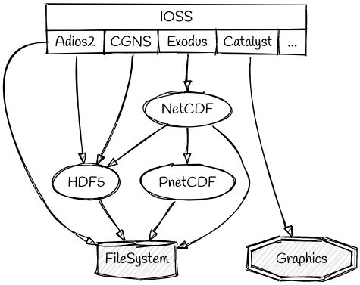
Finite Element I/O Tools: SEACAS
aprepro, algebra, blot, conjoin, cpup, ejoin, epu, exo2mat, exo_format, exodiff, exomatlab, explore fastq,gen3d, genshell, gjoin, grepos, io_shell, io_info, io_modify, mapvar, mat2exo, nas2exo, nem_slice, nem_spread, numbers, exotxt, txtexo, slice, zellij
Provide IO for Sandia finite-element applications
Provide applications and libraries for analyst workflow
Support Production Analysts and Path-Forward Developers
SEACAS contains the Exodus and IOSS finite element input/output libraries; applications supporting meshing, preprocessing, postprocessing, graphics, database translation; and support libraries..
Exodus is a model developed to store and retrieve data for finite element analyses in a random access, machine independent, binary file that is written and read via C, C++, or Fortran APIs.
The IO Subsystem (IOSS) is a high-level database access API designed to give a format-agnostic interface to I/O capabilities with multiple backends outputting data to multiple formats. Supported input and output formats are Exodus, CGNS, HeartBeat, History, Generated, Pamgen, TextMesh, ADIOS2, FAODEL, Catalyst2, Null.
Aprepro
Ioss
Zoltan
Exodus
ParMetis
NetCDF
MatIO
HDF5
PNetCDF
CGNS
A supercomputer is a device for turning compute-bound problems into I/O-bound problems

Slide 10
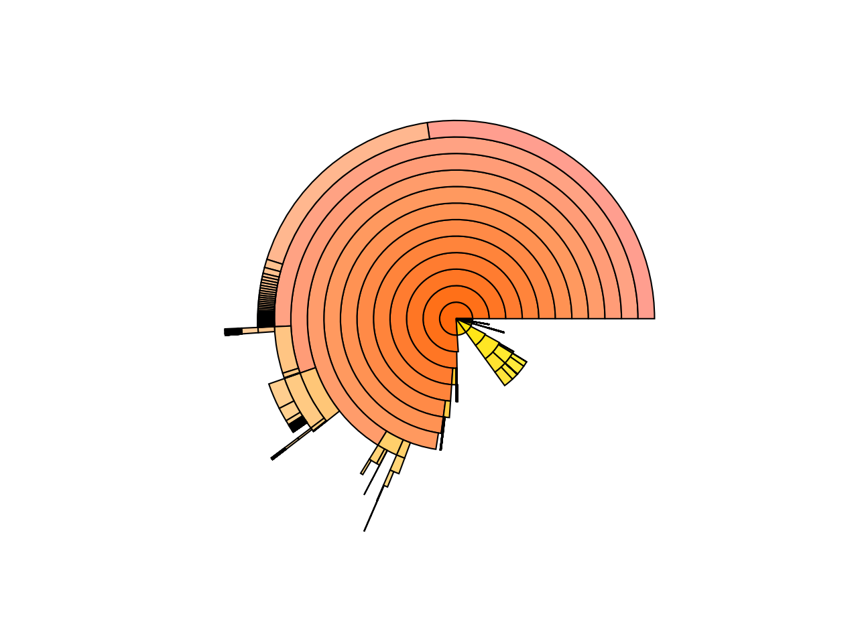
Teuchos: Common Package Utilities (pronounced “Tefos”)
NOX:
Direction:
Method: Newton
Newton:
Forcing Term Method: Constant
Rescue Bad Newton Solve: true
Stratimikos Linear Solver:
NOX Stratimikos Options: { }
Stratimikos:
Linear Solver Type: Belos
Provides a common look and feel
Capabilities:
Reference counted smart pointer (RCP)
ParameterList: runtime database (with yaml and xml I/O)
C++ Abstraction for an MPI Communicator
Timers
CPU BLAS/LAPACK wrappers
Scalar traits
Unit test harness
I/O Interface
Panzer MixedPoisson Test: 4.39393 [1]
| Mixed Poisson: 4.39382 - 99.9976% [1]
| | panzer::CubeHexMeshFactory::buildUncomittedMesh(): 0.000528984 - 0.0120393% [1]
| | panzer::CubeHexMeshFactory::completeMeshConstruction(): 0.765863 - 17.4305% [1]
| | panzer::DOFManagerFactory::buildUnqueGlobalIndexer: 0.0451156 - 1.0268% [1]
…
| | Ifpack2::Relaxation::initialize: 4.403e-06 - 0.000100209% [1]
| | Ifpack2::Relaxation::compute: 0.00249703 - 0.0568305% [1]
| | Belos: Operation Op*x: 0.00338377 - 0.0770121% [1]
| | Belos: PseudoBlockGmresSolMgr total solve time: 0.432027 - 9.83259% [1]
| | | Belos: ICGS[2]: Orthogonalization: 0.0212883 - 4.92755% [31]
| | | | Belos: ICGS[2]: Ortho (Norm): 0.000489003 - 2.29705% [31]
| | | | Belos: ICGS[2]: Ortho (Inner Product): 0.00904903 - 42.507% [60]
| | | | Belos: ICGS[2]: Ortho (Update): 0.00662776 - 31.1333% [60]
| | | | Remainder: 0.00512255 - 24.0627%
| | | Belos: Operation Prec*x: 0.0420421 - 9.73136% [31]
| | | | Ifpack2::Relaxation::apply: 0.0418983 - 99.658% [31]
| | | | Remainder: 0.000143774 - 0.341977%
| | | Belos: Operation Op*x: 0.104452 - 24.1772% [31]
| | | Remainder: 0.264244 - 61.1639%
…

Slide 11
Example Application

Slide 12

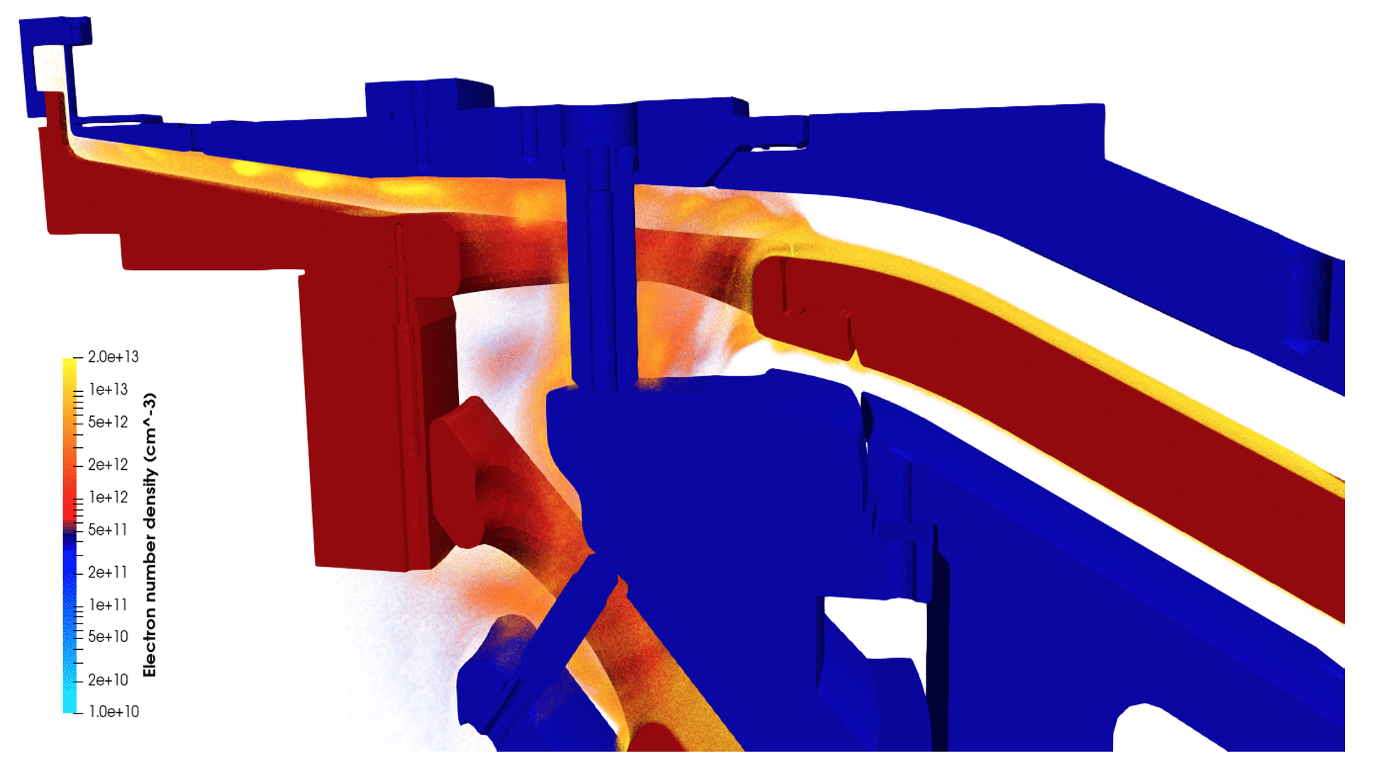
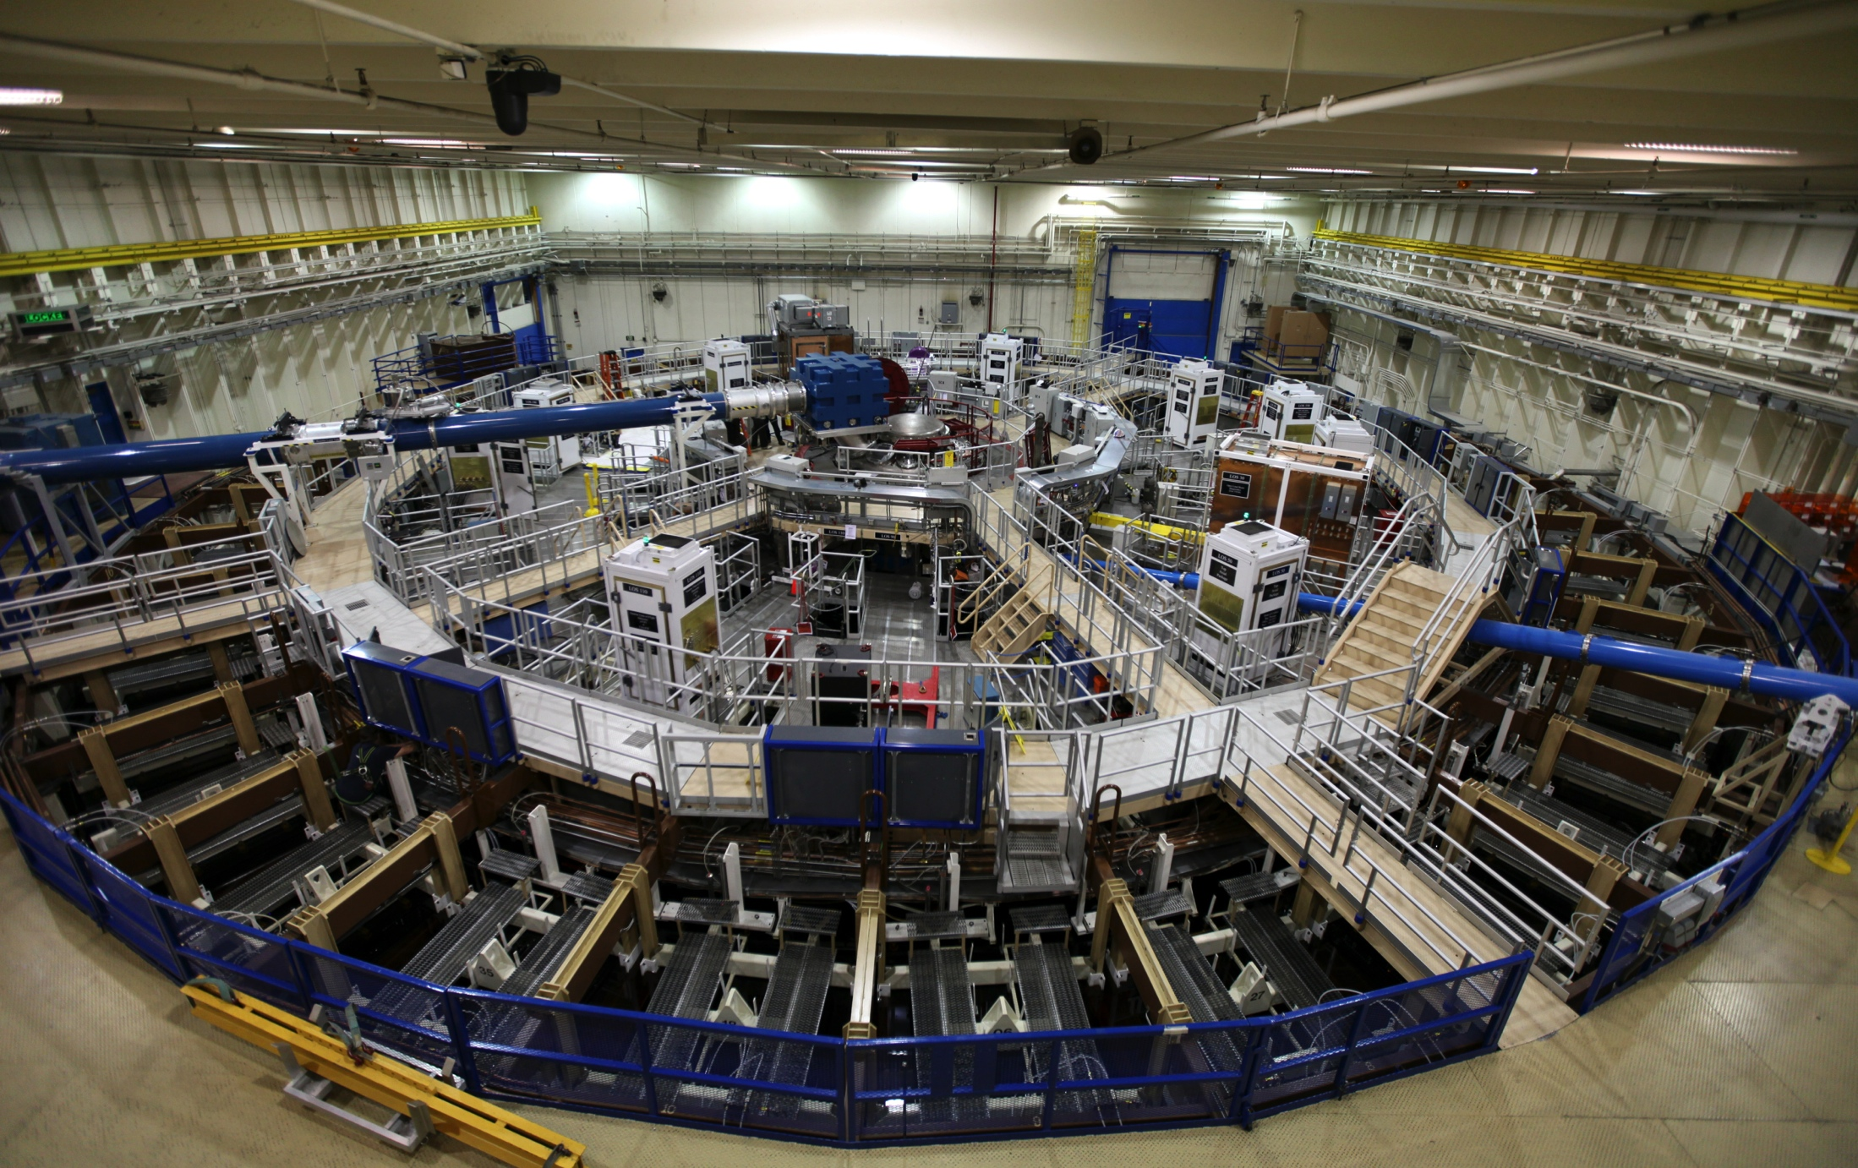
Empire models plasma effects in hostile nuclear environments
Empire is a plasma physics code used in weapon modernization work for hostile nuclear environments
Simulation is necessary - test facilities can only access parts of parameter space
Used extensively in conjunction with experimental facilities
Z: World’s most powerful pulsed-power facility and x-ray generator
Saturn: World’s brightest x-ray generator, tests electronics
HERMES-III: World’s most powerful gamma simulator, for testing electronics and military systems

Slide 13
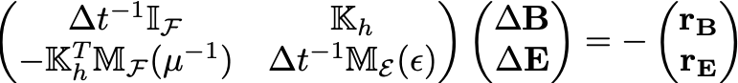
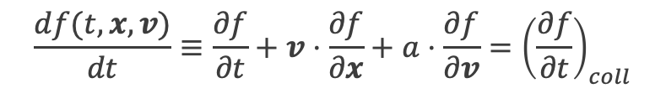
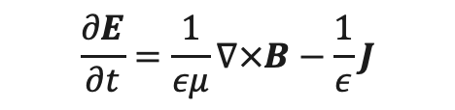
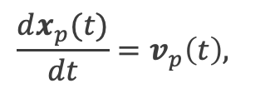

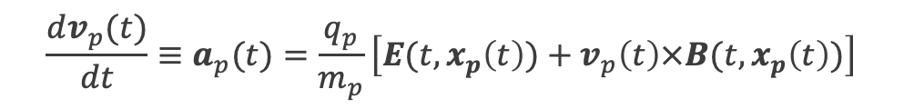
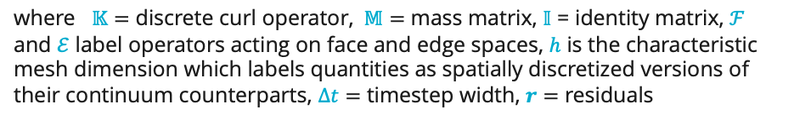
Empire’s Numerical Approach: FEM-PIC
Empire’s Particle-in-Cell (PIC) scheme¹ solves the equations of motion
$$\frac{dx_{p}(t)}{dt}=v_{p}\left(t\right),$$
Field Solve
$$\frac{dv_{p}(t)}{dt}≡a_{p}(t)=\frac{q_{p}}{m_{p}}\left[E(t,x_{p}\left(t\right))+v_{p}\left(t\right)×B(t,x_{p}\left(t\right))\right]$$
Weight Particles
The PIC Algorithm
Update Forces
encoded by the plasma kinetic equation for each particle ($p$):
$$\frac{df(t,x,v)}{dt}≡\frac{∂f}{∂t}+v⋅\frac{∂f}{∂x}+a⋅\frac{∂f}{∂v}={\left(\frac{∂f}{∂t}\right)}_{coll}$$
Move Particles
with fields evolved according to the Maxwell curl equations:
Flow diagram showing a pure PIC timestep
$$\frac{∂B}{∂t}=−∇×E$$
solved in strong form
solved in weak form
$$\frac{∂E}{∂t}=\frac{1}{εμ}∇×B−\frac{1}{ε}J$$
where $𝕂=$ discrete curl operator, $𝕄=$ mass matrix, $𝕀$ = identity matrix, $ℱ$ and $ℰ$ label operators acting on face and edge spaces, $h$ is the characteristic mesh dimension which labels quantities as spatially discretized versions of their continuum counterparts, $Δt=$ timestep width, $r=$ residuals
Using compatible discretization decisions^{2,3} ensures the Maxwell divergence constraints are satisfied for all time
¹Bettencourt, et. al., EMPIRE-PIC: A Performance Portable Unstructured Particle-in-Cell Code, 2021
²Nédélec J-C. Mixed finite elements in $ℝ^{3}$. Numerische Mathematik, 35(3):315–341, 1980.
³Raviart P-A. and Thomas, J. T. A mixed finite element method for 2nd order elliptic problems. Mathematical aspects of finite element methods, volume 606, pages 292–315. 1977

Slide 14
Empire was designed on a “Component” strategy
EMPIRE
Trilinos
Directly depends on 21 Trilinos packages
38 total Trilinos packages with indirect dependencies
Empire is built from the ground up for performance portability
Requires large-scale iterative linear solve for electromagnetics
I/O
Discretizations
Linear Solver
HDF5
Panzer
MueLu
NetCDF/P-NetCDF
STK
Ifpack2
H5Hut
Phalanx
Amesos2
DARMA/checkpt
Sacado
Belos
Intrepid2
Teko
RNG
Tempus
Thyra
Random123
Zoltan2
Tpetra
I/O
Linear Solvers: See Jonathan Hu’s Talk @2:15pm
Seacas
Teuchos
Discretization: See Mauro Perego’s Talk @2:35pm
Hardware Abstraction
Kokkos
KokkosKernels

Slide 15
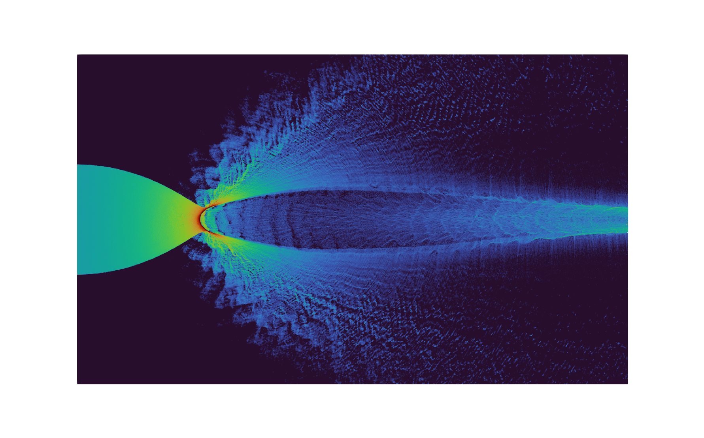
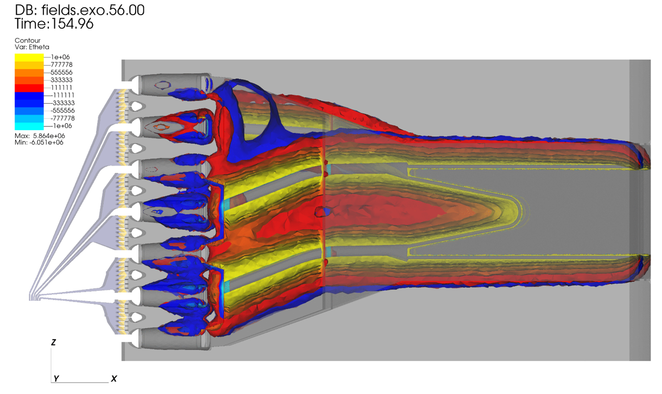
Use of CORE and DISCRETIZATION Components
Kokkos for underlying data structures of the entire code
Tpetra for parallel distributed linear algebra
Empire’s (yaml) input file uses Teuchos::ParameterList for parsing and validation
SEACAS is used to read and write mesh data
Zoltan used to load balance the finite element mesh for parallel simulations
Thyra used for blocked linear solves and coupling to circuits
Shards for cell topology
Intrepid2 for finite element (FE) bases
Phalanx for performance portability tools (view-of-views, virtual-function-on-device, …)
Panzer for mesh tools, periodic bcs and FE assembly
STK for runtime mesh database
Percept for uniform mesh refinement

Slide 16


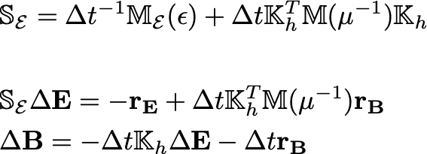
Electromagnetic Solver using Compatible Finite Elements
Meshing:
STK, Percept, SEACAS, Panzer
Data Structures:
Kokkos, KokkosKernels, Tpetra
Block LU Decomposition
FE Assembly:
Shards, Intrepid2, Panzer, Thyra
Assemble Schur Compliment as monolithic matrix
Linear Solve:
Uses RefMaxwell AMG with Conjugate Gradient
Chebyshev smoother
Prec setup done once
Belos, Teko, MueLu, Ifpack2, Amesos2, KokkosKernels, Zoltan2
Solve for dE with PCG:
Explicit back solve for dB:
Bettencourt, et. al., EMPIRE-PIC: A Performance Portable Unstructured Particle-in-Cell Code, 2021
Lourenco Beirao de Veiga, Konstantin Lipnikov, and Marco Manzini, Mimetic Finite Difference Method for Elliptic Problems.
Bochev et al., An algebraic multigrid approach based on a compatible gauge reformulation of Maxwell’s equations, 2008.

Slide 17
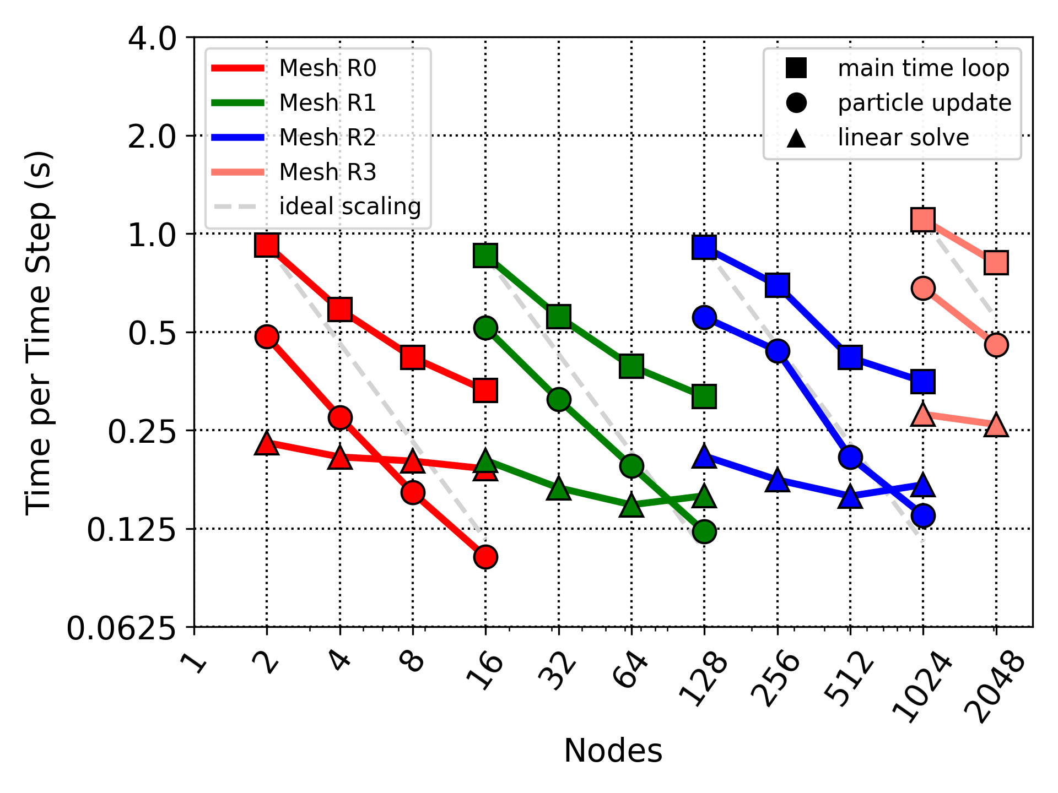
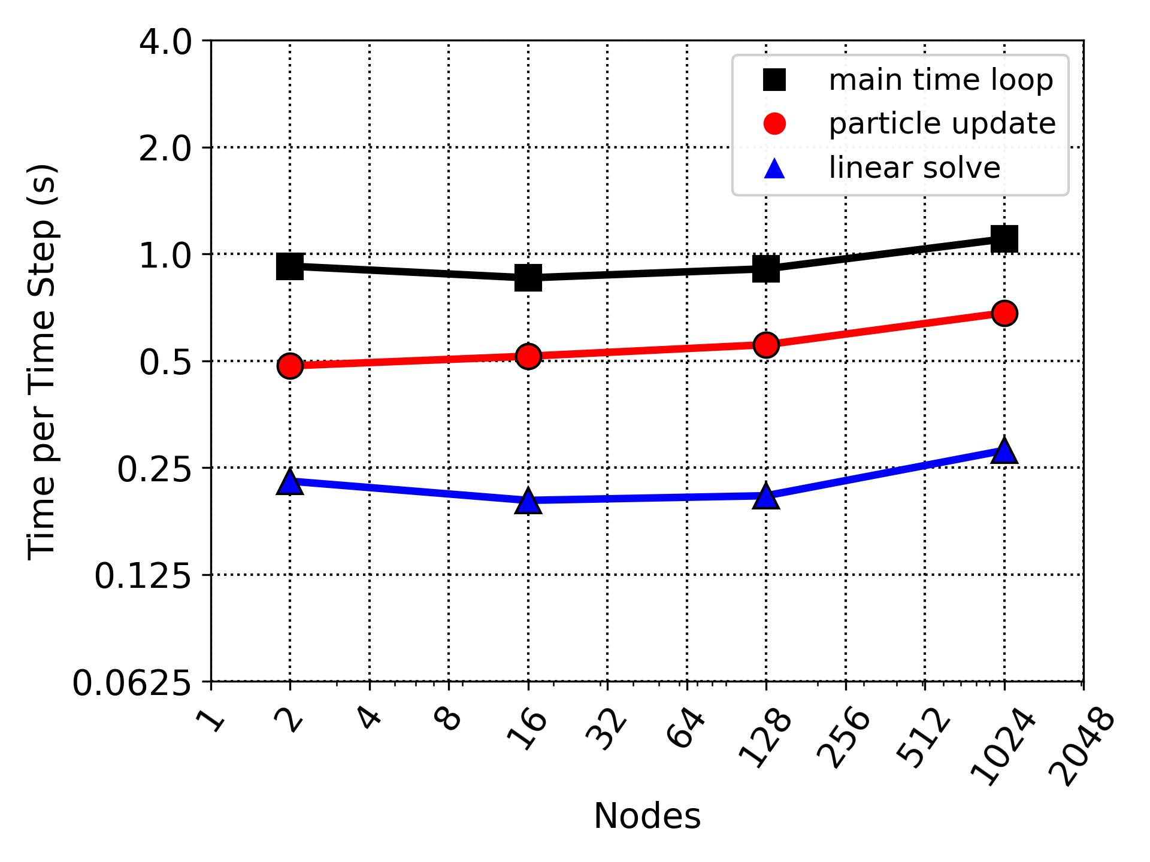
Scalability on cavity problem on ATS-2 Sierra (4 Nvidia V100 GPUs/NODE)
Strong Scaling
Weak Scaling
Largest Simulations: 1.6B Elements and 160B particles!

Slide 18
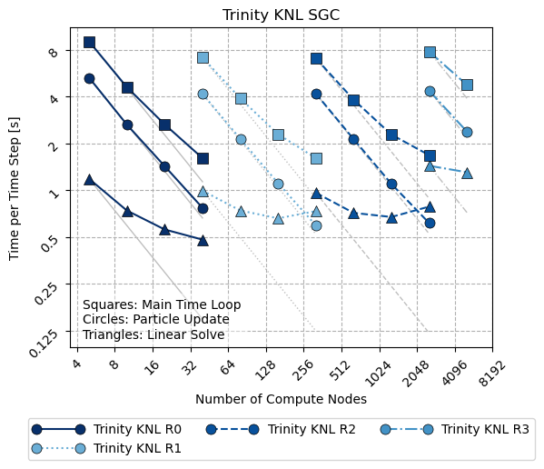
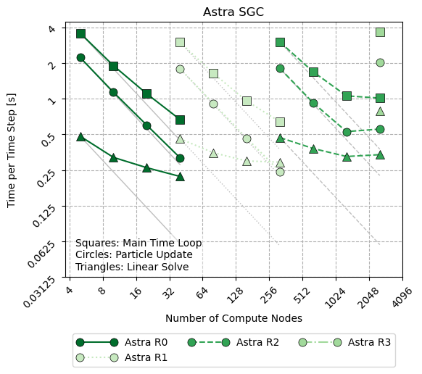
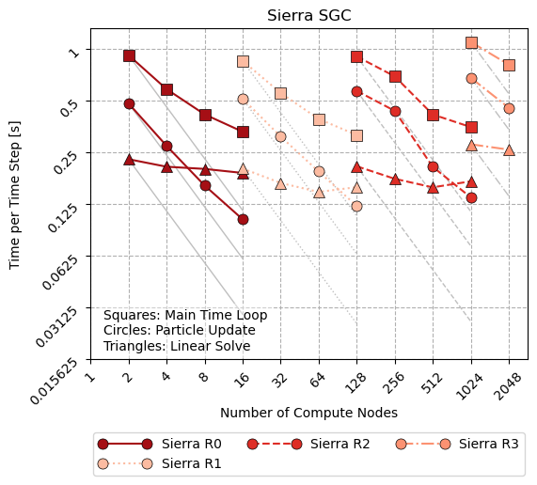
Performance Results for Generic Cavity
Single platform scaling results
Trinity/KNL
4 MPI/socket; 16 threads/MPI
Up to 5120 nodes (52% of total)
Astra
2 MPI/socket; 9 threads/MPI
Up to 2560 nodes (99% of total)
Sierra
4 GPU/socket; 1 MPI/GPU
Up to 2048 nodes (47% of total)
Time per time step (s)

Slide 19
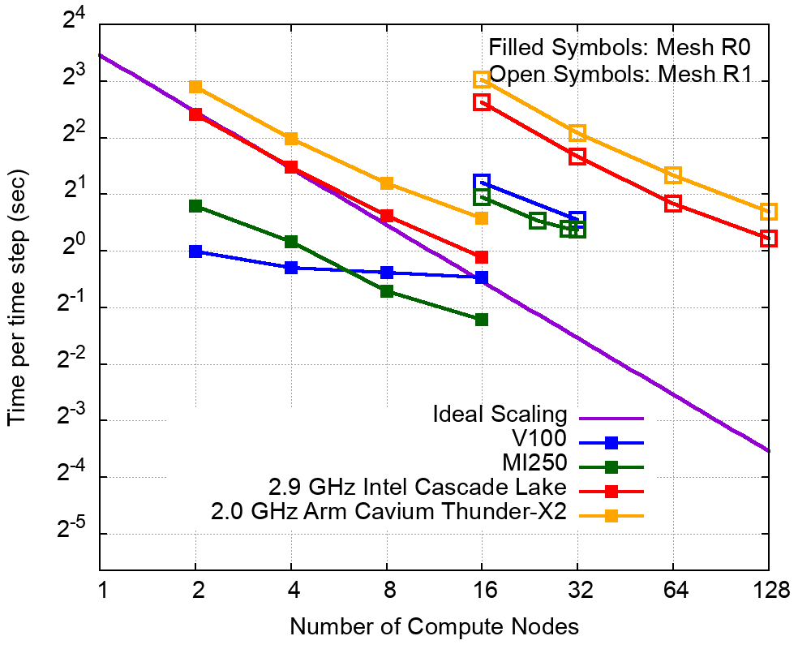
Performance Results on AMD GPUs (MI250X)
EAS3: 36 nodes available, will show results up to 32 nodes
Machines:
EAS3: 4 AMD MI250x GPUs per node
CTS-1: Intel Cascade Lake 48 cores per node
ATS-2: 4 NVIDIA V100 GPUs per node
Vanguard: 2.0 GHz ARM Cavium Thunder-X2, 56 cores per node
Two meshes, uniformly refined:
Default linear solve used on EAS3. No work to date on optimizing the linear solve on EAS3!
Other platforms all have linear solves that were hand tuned/optimized for the hardware.

Slide 20
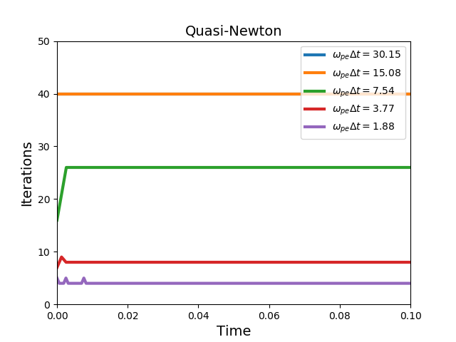
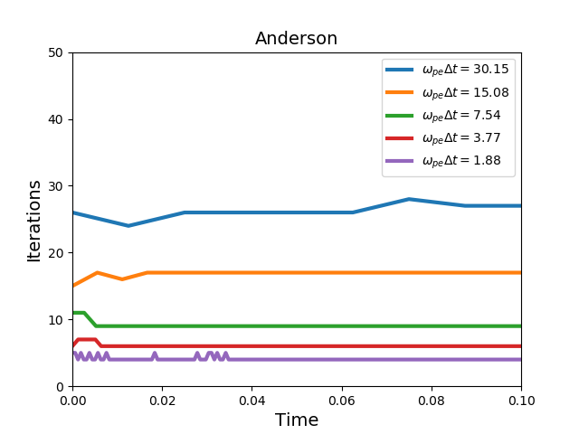
Anderson Acceleration Improves Performance
Hybrid Two fluid plasma vortex in MHD limit
IMEX time discretization, DG fluid discretization, coupled to CG Maxwell discretization
Using Schur-Complement in all simulations
Fluid block diagonal solver: KokkosKernels: KokkosBatched_LU and KokkosBatched_Trsm
Coupled outer solve: NOX for Anderson Acceleration

Slide 21
An Incomplete list of contributors
Trilinos Core Area
Chris Baker
Ross Bartlett
Erik Boman
Karen Devine
Christian Glusa
Roger Pawlowski
Chris Siefert
Greg Sjaardema
Heidi Thornquist
Jonathan Hu
Michael Heroux
Daniel Ibanez
Mark Hoemmen
Kevin Long
Christian Trott
Damien Lebrun-Grandie
Siva Rajamanikan
Luc Berger-Vergiat
Empire
Matt Bettencourt
Keith Cartwright
Eric Cyr
Adam Darr
James Elliott
Daniel Jensen
Todd Kordenbrock
Richard Kramer
Caleb Logeman
Ed Love
William McDoniel
Duncan McGregor
Logan Meredith
Chris Moore
Roger Pawlowski
Edward Phillips
Bryan Reuter
Sid Shields
David Sirajuddin
Shane Stafford
Scot Swan
And many more…

Slide 22






Summary
Trilinos provides powerful tools for modeling complex physical systems
The “Core” product area supplies foundational building blocks for other packages
Trilinos enables scalable large-scale simulations on multiple architectures

